Slide 1
8 bit vs 16 bit Microprocessor: A comparative study
8085/8 bit | 8086/16 bit
8 bit data bus, 16 bit address line | 16 bit data bus, 16 bit address line
5 Flags and 64 KB memory capacity | 9 Flags and 1 MB memory capacity
Does not support memory segmentation, maximum or minimum mode & pipelining | Supports memory segmentation, maximum or minimum mode & pipelining
Accumulator based | General Purpose Registers based
One Processor used | An additional external processor can also be employed.
Low Cost | High Cost

Slide 2
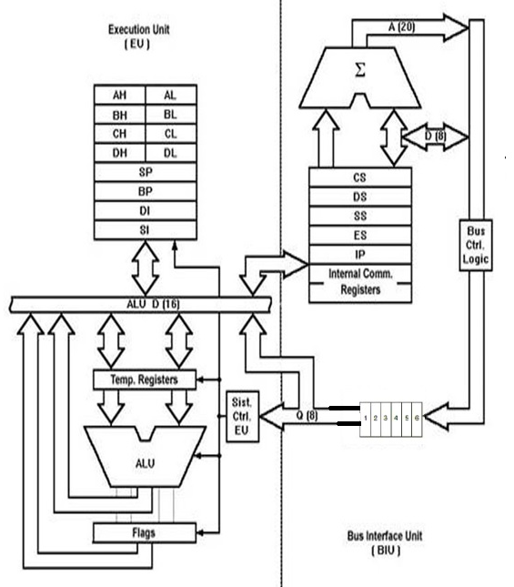
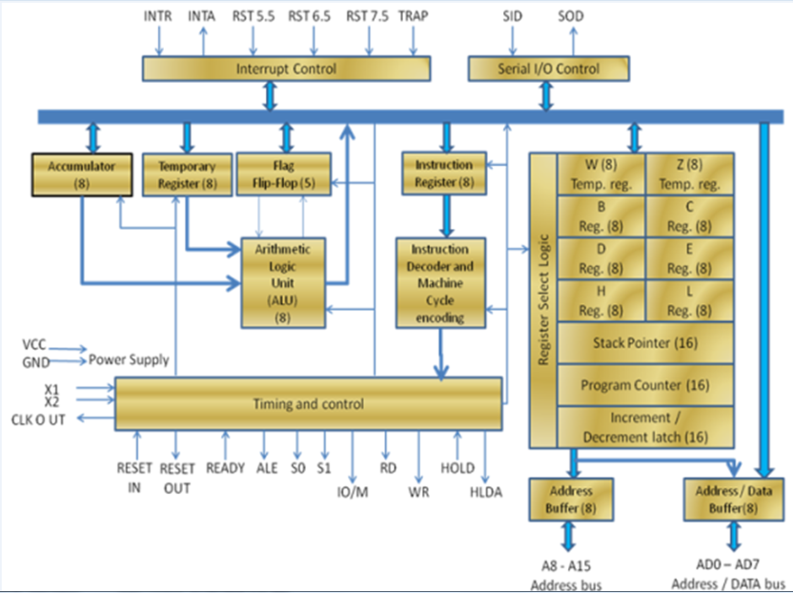
8 bit vs 16 bit Microprocessor: A comparative study

Slide 3
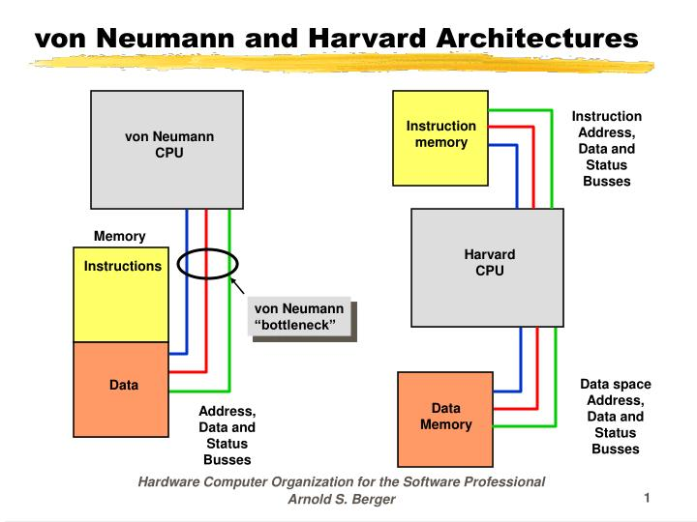
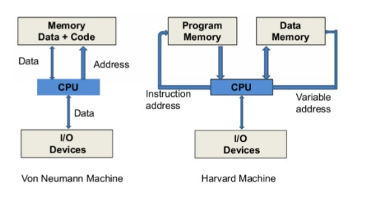
Von Neumann vs Harvard Architecture

Slide 4
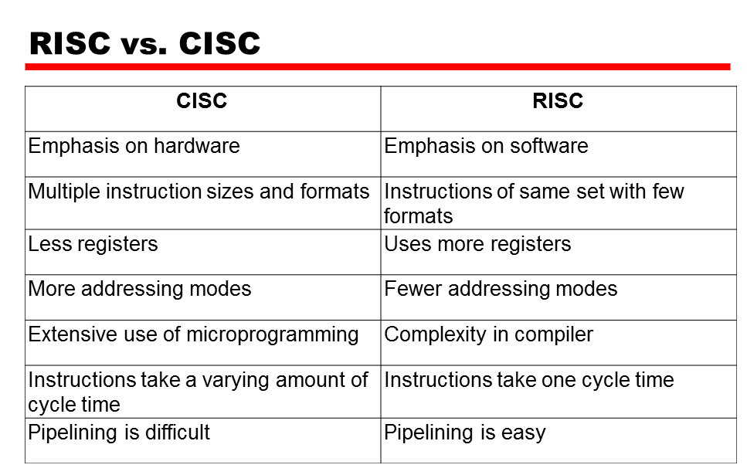
RISC vs CISC

Slide 5
Microprocessor vs Microcontroller
Microprocessor | Microcontroller
Just a processor. Memory and I/O components have to be having to be connected externally. | Contains external processor along with internal memory and I/O components.
Since I/O and memory connected externally, the circuit becomes large. | Since I/O and memory present internally, the circuit is small
Power consumption and cost is high | Power consumption and cost is low
Most of the microprocessors do not have power saving modes. | Most of the microcontrollers have power saving mode.
Mainly used in personal computers. | Used mainly in washing machine, MP3 players
Can't be used in compact systems and hence inefficient. | Microcontroller is an efficient technique.

Slide 6
THANK YOU

